Slide 1

Presentation Title: HTTP/1.0
Course Tile: Computer Networks
Course Code: ICT-3201
Presented By:
Imran Hamid
ID: IT22010
Year: 3rd Sem: 2nd
Session: 2021-22
Dept. of ICT,
MBSTU
Supervised By:
Dr. Nazrul Islam
Associate Professor
Dept. of ICT,
MBSTU

Slide 2
Table of Contents:
Introduction
Overview of HTTP/1.0
Main features of HTTP/1.0
Architecture and Working Principle
Methods used in HTTP/1.0
Real world example/Use case
Advantages of HTTP/1.0
Limitations of HTTP/1.0
Conclusion

Slide 3

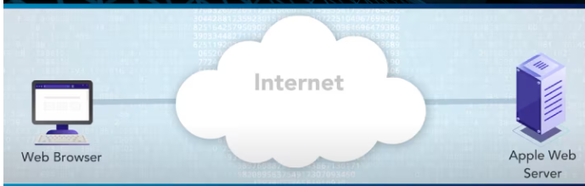
Introduction:
What is HTTP?
HTTP (Hyper Text Transfer Protocol) is the communication protocol used for transferring data between a web browser and a web server over the internet.
HTTP was developed in the early 1990s by Tim Berners-Lee at CERN to enable communication between web browsers and servers.
The first version, HTTP/0.9, was very simple
It only supported the GET method.

Slide 4
Overview of HTTP/1.0 :
HTTP/1.0 is the first standardized version of the Hyper Text Transfer Protocol (1996) that allows a web client to request resources from a web server using a simple request–response model.
Goals and Purpose of HTTP/1.0:
1.Provide a standardized protocol for communication between clients and servers
2.Enable transfer of HTML pages, images, audio, video, and other resources
3.Introduce status codes to indicate success or failure of requests
4.Add headers for more structured and informative responses
5.Support multiple request methods: GET, POST, and HEAD

Slide 5
Features of HTTP/1.0:
1. Stateless Nature: Each request is independent; the server does not store previous interactions. Every request must include all needed information.
2. One Connection per Request: A new TCP connection is made for each request and closed after the response, causing delays when loading multiple resources.
3. Headers, Status Codes, and Methods: HTTP/1.0 introduced headers (metadata), status codes (like 200 OK, 404 Not Found), and basic methods:
GET – request data
POST – send data
HEAD – get headers only

Slide 6
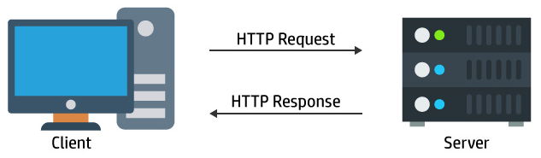
Architecture and Working principle:
Client Server Model
Client: Web browser or HTTP client
Server: Web server that provides resources
Communication: Client sends request → Server sends response

Slide 7
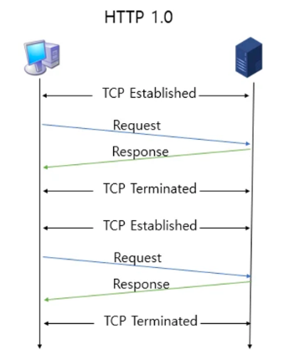
Architecture and Working Principle (Continue…….)
Request Response Flow:
TCP connection Establishment
Request Transmission
Server Processing
Response Transmission
TCP connection closure
Each time a request is made, a new TCP connection is established to perform the task .

Slide 8
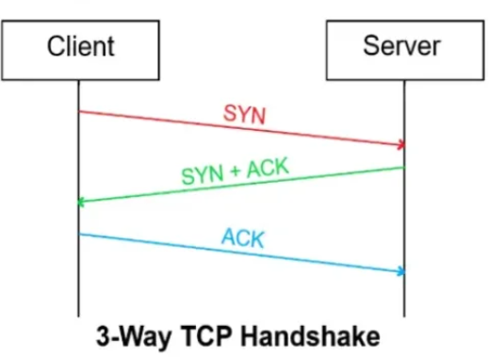
Architecture and Working Principle (Continue…….)
TCP Connection establishment:
Client initiates a TCP connection to the server (3-way handshake).
SYN: Client → Server
SYN-ACK: Server → Client
ACK: Client → Server
✅ Now the connection is ready for data transfer.

Slide 9
Architecture and Working Principle (Continue…….)
Request Transmission:
Client sends HTTP request.
Includes: Method(GET,POST), URI, HTTP/1.0, headers, and optional body.
Server Processing:
Server reads and processes the request.
Retrieves data or runs scripts.
Response Transmission:
Server sends HTTP response.
Includes: Status line, headers, and optional body (HTML, image, etc.).

Slide 10
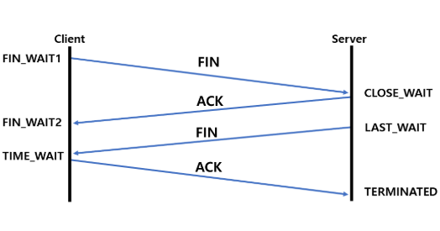
Architecture and Working Principle (Continue…….)
TCP Connection Closure: The server closes the TCP connection after sending the response, and the client processes it.(4 way handshake)
TCP Connection Termination:
FIN: Sender → Receiver
ACK: Receiver → Sender
FIN: Receiver → Sender
ACK: Sender → Receiver
Connection is now fully closed

Slide 11
Methods used in HTTP/1.0:
Method | Purpose | Example Request Line
GET ---------------------------------------> | Retrieve a resource from the server | GET /index.html HTTP/1.0
POST--------------------------------------> | Send data to the server (form submission) | POST /login HTTP/1.0
HEAD-------------------------------------> | Fetch headers only, no body | HEAD /index.html HTTP/1.0

Slide 12
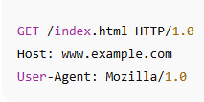
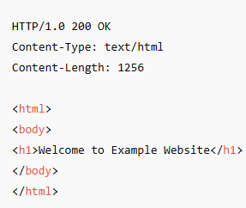
Real world example/Use Case:
In the early web (1990s), websites like www.yahoo.com or www.netscape.com used HTTP/1.0 for communication.
Example of simple request:
When a browser sends a request: Server Response:
After sending the response, the TCP connection closed, and a new one had to open for the next request(like loading images or CSS)

Slide 13
Advantages of HTTP/1.0:
Simplicity
Widespread early adoption
Foundation for web communication

Slide 14
Limitations of HTTP/1.0:
Lack of persistent connections
Inefficient for multiple requests
No host header (problem with virtual hosting)

Slide 15
Conclusion:
HTTP/1.0 was the first standardized version of the Hypertext Transfer Protocol, introducing a simple stateless request-response model with basic methods like GET, POST, and HEAD. Although it required a new connection for each request and had some limitations, it laid the foundation for web communication and influenced all later versions. Over time, it evolved into HTTP/1.1, HTTP/2, and HTTP/3, improving speed, efficiency, and security. HTTP/1.0 may be old, but it paved the way for the modern, fast, and secure web we use today.

Slide 16
Thank You

